Slide 1

FinanceAI Use Case Overview
June 2024

Slide 2
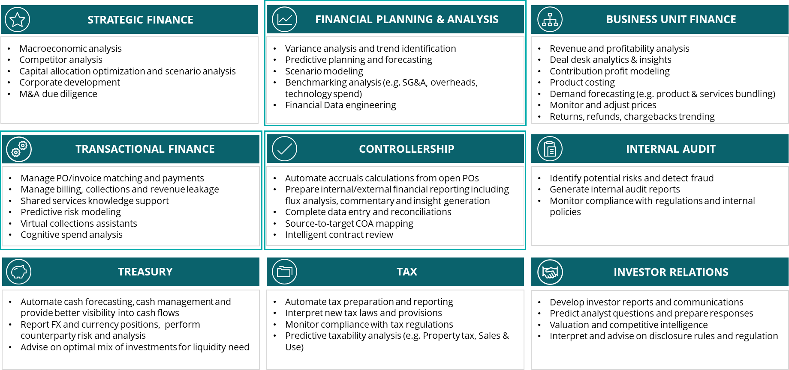
From Use Cases to End-to-End Finance Transformation
  Moving from one-off use cases…
  …to INTEGRATED and HOLISTIC capabilities.
Illustrative AI Quote to Cash Solution
1
ORDER MANAGEMENT
Identify new revenue opportunities (cross-sell/upsell)
Create, track and manage orders
2
BILLING
Generate and send out invoice; proactive correction of invoice errors
Predicts late payments or defaults
3
CREDIT &
CASH APP
Match payments received with correct invoices
Automated reminders about overdue payments
4
REVENUE
Read customer contracts and identify performance obligations for revenue recognition
Identify & proactively correct revenue leakage
Challenges With One-Off Use Cases
Advantages of end-to-end AI Solutions
Use-case scope is narrow and targets functions in silos, thereby limiting benefit realization across Finance
Higher cost of ownership for one-off technical efforts
Broader scope across Finance provides opportunity to deliver higher value transformative solutions
Provides greater return on investment for client
As part of our Global Use Case Repository we will begin to align to the end-to-end solution structure.

Slide 3
Finance Use Cases (1 of 2)
<>
Process Area | Use Case Description | Capabilities | AI Technology | Finance Functions Impacted
Quote-to-Cash | Invoice and Collections Standardization | Automated invoice error detection & correction | ML Predictive + GenAI | AR Revenue Accounting GL | Transactional Finance Tax
 |  | Generate customized invoices for nonstandard customer orders | GenAI
 |  | Facilitate payment collection to identify collections gaps and automate outreach and processing | GenAI-enabled “virtual assistant”
Procure-to-Pay | Expense and Profitability Management | Using data from contract management system, forecast monthly expense for all third-party contracts | Predictive Analysis | Expense Management Revenue Accounting FRM | Control & Compliance Debt & Capital Markets
 |  | Capture all variations and exceptions in P2P and O2C, enabling a touchless financial close | AI-enabled process mining
 |  | Examine market trends, supplier behavior, and other relevant factors to determine optimal prices, make pricing adjustments, and maximize profitability | Predictive Analysis + GenAI
Record-to-Report | Reporting and Compliance | Generate draft regulatory filings | GenAI | Internal Audit | Tax
 |  | Monitor emerging regulations and evaluate current state compliance | NLP
 | General Accounting and Reconciliation | Monitor potentially suspect or fraudulent journal entries in real time | LLM | Internal Audit General Accounting | Controls & Compliance
 |  | Generate account variance analysis and intelligent explanations | LLM
Working Capital | Cash Forecasting | Enhance cash flow analysis by minimizing liquidity risks, improving forecasting accuracy, maximizing cash turnaround time and minimizing DSO | Predictive Analysis | Treasury Operations FRM | Debt & Capital Markets Investments

Slide 4
Finance Use Cases (2 of 2)
<>
Process Area | Use Case Description | Capabilities | AI Technology | Finance Functions Impacted
Capital Project Management | Capital Investment Planning | Generate investing strategies from consolidated market conditions, internal financial performance, and firm objectives | GenAI + LLM | Strategic Finance Debt & Capital Markets Investments | Forecasting Insights & Decision Support BU Finance
 |  | Generate executive level overview of company financial health | NLP
 |  | Identify past data patterns to predict and improve future financial performance | ML Predictive + GenAI
Planning, Budgeting, Forecasting | Budgeting and Forecasting | Develop guided workflows for creating budgets that can consider financial metrics and user input | Predictive Analysis + GenAI | Long-range Strategic Planning Budgeting | Forecasting Insights & Decision Support
 |  | Summarize and score project proposals across the organization to facilitate executive review | Predictive Analysis + GenAI
Treasury | Cash and Foreign Currency Management | Enhance cash flow analysis, minimizing liquidity risks, improving forecasting accuracy, and maximizing returns on cash holdings | Predictive Analysis + GenAI | Treasury Operations FRM | Debt & Capital Markets Investments
 |  | Optimize foreign exchange operations by evaluating foreign exchange data by identifying patterns and trends to reduce financial risks | Predictive Analysis + GenAI
Tax Management | Tax Filing and Legal Compliance | Automate tax filing processes, analyze financial data, and generate accurate tax reports | NLP | Tax Accounting & Provision | Direct & Indirect Tax Compliance
 |  | Evaluate tax laws and regulations and provide recommendations for tax planning, compliance, and risk management | NLP
Commercial Finance | Narrative Reporting | Evaluate datasets and priorities for the business to drive analysis, benchmarking, and insights | Private LLMs | Strategic Planning Budgeting Forecasting | Management Reporting Insights & Decision Support

Slide 5
From Discrete Use Cases to End-to-End Finance Transformation with AI
In progress: new client facing use case 1-pager (most “in demand” use cases)
Transactional Finance
Order-to-Cash
Source-to-Pay
Close-Consolidate-Report
Reporting
Proactive invoice correction
Revenue leakage identification & correction
Proactive cash collection alert & outreach to customer
Recommend optimal payment terms to improve DSO
Touchless financial close
Predictive risk model to mitigate customer/supplier risk
Recommend most optimal payment timing
Predictive cash flow forecasting tool
Automated financial statement preparation
Narrative MD&A draft generation
Draft regulatory reports generation
Evaluation current compliance and monitor emerging regulations
Proactive real-time notification of potential suspect journal entries
Generate account variance analysis and intelligent explanations
Working Capital Optimized by AI
Commercial Finance
FP&A
Business Unit Finance
Capital Planning & Optimization
Strategic Finance
Chat-with-my-Finance data*
Recommend guided workflows for creating budgets
Project proposal executive level summarization and score
Automate financial data across diverse sources
Recommend demand planning, product costing, and pricing setting
Proactive defect resolution recommendations
Investing strategy recommendations
Executive level overview of company financial health generation
Predictive financial performance from data patterns
Project-level recommendations
Recommend, summarize, and detect risk from M&A cleanroom data
Generate various scenario models
Enable predictive challenger models to test various scenarios
Specialized Finance
Treasury
Tax
Internal Audit
Investor Relations
Predictive cash flow forecasting and analysis tool
Proactive foreign exchange monitoring
Automation of tax filings
Accurate tax report generation
Predictive tax planning, compliance, and risk management
Proactive detection of fraudulent activities
Draft audit report generation
Predictive compliance monitoring
Predictive company valuation analyzing financial data
Financial rules and regulations interpretations
Draft sections of 10Q / 10K generation
*Live client POC / MVP

Slide 6
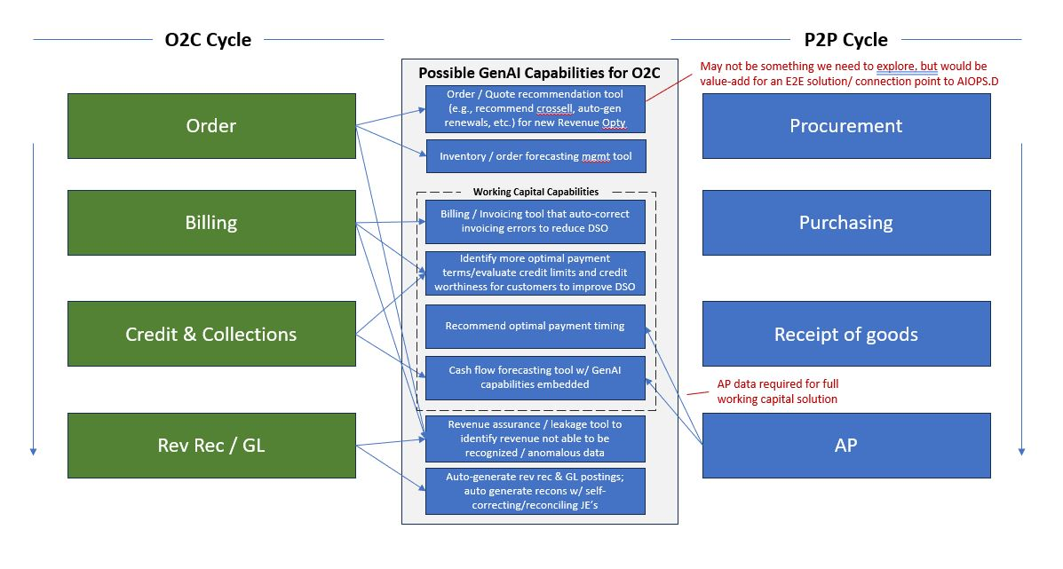
Rough sketch to blow out the dotted line box on slide 5

Slide 7
Finance taxonomy
Domain
CFO Strategy
Strategic Finance
Financial planning and analysis (FP&A)
Business unit (BU) finance
Transactional finance
Controllership
Internal audit
Treasury
Tax
Investor relations
Finance visioning
Long-range
planning
R&D finance
Source-to-pay
Close
Risk assurance
Treasury operations
Tax accounting and provision
Capital markets financing and valuation
Capital optimization
Budgeting and forecasting
Commercial sales
finance
Order-to-cash
Consolidation
Risk advisory
Financial risk management
Direct tax compliance
Regulatory and governance
Capability
Corporate development
Performance management reporting
Manufacturing and supply chain finance
Capital asset management
External and internal reporting
Risk sensing and foresight
Debt and capital markets
Indirect tax compliance
IR planning and strategy
Finance Transformation
Insights and decision support
Pricing
Project accounting
Financial analysis
Investments
Tax technology advisory
Enterprise transformation
Business case
evaluation
Subledger close
Tax advisory
Operational reporting
Tax controversy and audit support
Enablers
Process and technology
Data and analytics
Talent and delivery model
Governance, risk, and controls

Slide 8
Generative AI for Process Automation
Use Case
1.1: Minimize / Eliminate Month End Close Processes
1.2: Contract Lifecycle Management
1.3: Sales Order Processing
1.4: Automated & Optimized Stock Replenishment
1.5: Analytics and Dashboards
Use the month end process to identify and correct operational issues that occurred during the month. Significant time and resource commitment
Service contracts are written up manually by leveraging templates. Highly manual and error prone, with no ability to automate monitoring compliance
Sales orders are still received manually / calls / emails from customers and entered into SAP by customer service representatives
Stock replenishment is based on daily MRP runs and manual decisions by the planners for each location
Pre-built dashboards for key KPIs, inflexibility in using disparate sources of information to generate real-time insights
Current State
Use GenAI to identify and address transaction processing errors on a real-time basis and minimize / eliminate month end processing
Automate contract authoring, negotiations and sign-off processes using GenAI. Drive to continuous compliance monitoring
Combine GenAI with optical character recognition to fully automate the creation of sales orders in SAP; focus customer service on managing exceptions
GenAI will drive auto stock replenishment across the entire network based on real-time consumer data, demand variability and supply constraints
Dashboards / information is generated real-time based on user questions, independent of the source of the various underlying data
Future State
Benefits:
Reimagine business processes to not only “execute activities more efficiently” but to rethink “what activities are required”
Reduce End to End Cycle time of business processes, unlocking significant efficiencies
Unlock net new capabilities that were once deemed unachievable (e.g. real-time business performance insights & associated actions)

Slide 9
Corporate Finance – AI Use Case Overview & Opportunities for Generative AI
Standardized and repetitive tasks across corporate finance processes are ripe for AI disruption
Record
Close
Report
Plan
Key Activities
General accounting
Monthly closing activities
Capital investment planning
Regulatory compliance
Account reconciliation & analysis
Master data management
Financial statement consolidation
Budget & forecasting
Enabling AI Capabilities
Identify inconsistencies in master data records
Identify missing monthly accruals based on historic trends
Reconcile account balances at the transaction level to underlying documents like invoices, purchase orders, and bank statements
Automated closing checklists to ensure all accounting policies are followed
Consolidate accounting records recorded under different standards and currencies
Generate draft regulatory filings such financial statement disclosures, proxy statements, and others
Guided workflows for creating budgets that can consider financial metrics and user input
Generate investing strategies from consolidated market conditions, internal financial performance, and firm objectives
Guided, adaptable workflows for master data record changes
Real time monitoring of potentially suspect or fraudulent journal entries
Identify unusual entries recorded during the close period for further review
Consolidate written financial reports in various formats into one compliant and uniformly formatted report
Monitor emerging regulations and evaluate current state compliance
Summarize and score project proposals across the organization to facilitate executive review
Identify patterns in past financial data to predict and improve future financial performance
Generate metadata documentation for account balance descriptions and other master data objects
Generate period to period account variance analysis and intelligent explanations
Identify expense classification errors through clustering and classification models trained on historical data
Generate executive level overview of company financial health
Key
Generative AI Use Cases

Slide 10
What We Sell Strategy
We are focused on selling Solutions that combine our core advise, implement, and operate services
alongside AI products (Deloitte products and/or external products).
Primary focus area as we accelerate
Service Offering
Product Offering
Advise
Strategic assessment to advise client on use case selection, technology selection
Advisement on long-term AI strategy for Finance org
AI Value Case
Implement
MVP design / build / on client selected platform (Deloitte, external vendor)
Extent of implementation dependent upon client AI maturity & ambition
Operate
Long-term operation & management of AI solution / technology
Support of AI foundry model for Finance
Deloitte Solutions/Assets
Core Deloitte developed AI platforms
AIOPS.D
CFO GPT / FinanceAI Analyst
PrecisionView
AI Studio
PAIR.D
Custom/private LLMs (ARIA)
External Vendors
3rd Party AI Solutions & Platforms
Hyperscalers + Public LLMs
AI capabilities in existing tools (e.g., AI-enabled capabilities in ERPs)
Solutions Offering (Service + Product)
Service Offerings
Product Offerings
Solutions Offering
Our primary focus on WHAT WE SELL will be oriented to Solution Offerings – the bringing together of our Advise, Implement, Operate services alongside our proprietary Deloitte AI products & solutions (or, 3rd party vendors dependent upon client needs and preferences).
Advise
Implement
Operate
Deloitte Solutions
External Vendors

Slide 11
Corporate Finance – Generative AI Improvement Opportunity Examples
Transform the way the enterprise engages in capital budgeting and financial reporting by offering generative AI-powered solutions to accelerate planning and development processes
Opportunity | Current State Leading Practices | Generative AI Solution | Marginal Benefits with Gen.
Budget & Investment Planning | Manually review compiled budgets & forecasts Compile feedback across different verticals and summarize Modify plan based on feedback | Generate budget documentation and revision materials based on previous successful budgets Finetune budget planning documentation with specific requests via text prompts automating the process with human oversight | Prompt based document revisions for specific budgeting requirements Decrease time spent drafting overhead documentation for leadership review
Month End Reporting | Account level activity is manually reviewed to understand variance drivers and generate relevant commentary Synchronous, executive level meetings are required to discuss variances | Generate concise, understandable explanation of cost and revenue drivers of account level variance A interactive UI could allow natural language inquiries about the variances and reports | Less time spent on aggregating data and diving into account variances Time efficiencies from fewer synchronous month end close meetings
Generate Regulatory Filings | Semi-automated processes to generate the input figures Manual process to aggregate financial data and elaborate to conform to regulatory filing needs | Generate first drafts derived from previous filings, internal financial information, and filing requirements guided by workflows Highlight potential edits influenced by filings of other companies | Less time wordsmithing initial drafts Less time spent researching historical fillings Guided workflows act as a completeness check
c) Generate Regulatory Filings
Generate draft filings of various regulatory documentation
Generative AI can support the process of creating regulatory filings by saving time in the initial drafting stages by learning regulations, workflows, and patterns in previous documents.
Guided workflows provided a structured format to specify the type of filing to generate, the type of information to include, and the desired objective of the filing (i.e. a proxy statement that highlights the equity incentive plan and the result of the board of director's vote)
LLM can identify patterns in historical internal and external filings to generate first drafts, saving time otherwise spent wordsmithing to transition ideas to formatted legal documents
Summary of the filing and considerations taken generated for supplemental review by executive level.

Slide 12
Deep-Dive into Select Gen AI Applications in Finance
FP&A
Transactional Finance
Controllership
Monthly Reporting
Company Report
Account / Transactional Inquiries
Global Business Services
Report Reconciliation
Regulatory Adherence
Perform account level variance analysis
Manually review compiled budgets & forecasts
Compile narrated report for distribution
Closely monitor regulatory requirements
Manually draft and publish the company reports
Prepare scripts for earnings calls and analyst briefs
Customer Rep assigned to a small number of customers
Rep efficiency dependent on familiarity with customer’s account
No aggregated knowledgebase for resolution
SOP’s and FAQ’s are manually documented by experienced resources
Valuable resources deployed performing low value tasks
Financial documents are manually tied out to underlying support
Financial reports are tied out internally to ensure mathematical accuracy and balancing
Gap analysis is manually performed as a completeness check against missing disclosures
New regulations must be sorted through and applied or developed into accounting policy
Current State Leading Practices
Automatically generated draft periodic management reports – both numeric, format and narrative
Monitor regulatory changes actively
Automatically generated a draft version of the company report
Past incident history mined and analyzed to assist in future transactional research
Intelligent self-service chatbot to resolve customer concerns
New SOP’s generated on the fly to capture small changes in processes
Q&A chatbot to guide new employees through SOP’s
Reports are tied out automatically
Variances are identified and potential causes are explained (with drivers / root causes)
Automated review and summarization of potential gaps in disclosures
New regulation is filtered on applicability and impact is summarized
Generative AI Solution
Faster Close
Shorter “time-to-insights” cycles
Broader scope of variance analysis
More comfort in disclosure completeness
Ability to proactively plan for reg changes
Value Enabled

Slide 13
F&P Priority Use Cases
Six priority use cases have been identified to develop and explore with clients – these will form part of a broader FinanceAI platform concept, and provide necessary experience to evolve our offerings
Use Case
FinanceAI
Insights Platform
Mgmt Reporting – Actuals, Plan, Variance + Commentary
Shared Services Interaction Layer -
Intake / Automation
Forecasting & Scenario Modeling – Automated / On Demand
Journal Entry Automation – Journal Entry Automation
IR Analyst Augmentation –Scripts, Q&A, Articles
Significant human time and effort is consumed, analyzing and summarizing financial performance data and reports to provide leaders with actionable insights.
Management reporting is labor intensive with humans connecting datasets, addressing data issues, producing reports, analysis and commentary
Employees interact with shared service functions in various, fragmented and rigid ways using multiple communication mediums.
Forecast accuracy and timeliness limit true effectiveness. Scenario modeling is unavailable or lacks enough functionality to meet business needs
Meetings and emails across teams create a bottleneck and slow the pace of close activities. AJE documentation is fragmented, and results are inconsistent
Financial information and commentary is manually consolidated and iterated from multiple sources and reviewed with business leaders to come up with a script and Q&A plan.
Current State
Perform analysis & investigation, and provide 1st order insights on demand from multiple financial sources
Produce mgmt reporting & analysis (Version 1) on demand in any medium including insights and commentary
Provide a new conversational AI (chatbot) interaction layer where employees can request any services based on free-form request
Provide end users with on demand forecasting and scenario modeling functionality with complete parameters and drivers flexibility
Automated proposed AJEs are drafted and reviewed with applicable stakeholders in real-time, with limited resource follow-ups, and automated summarized documentation
Automate, accelerate and generate 1st version artifacts for earnings and investors (e.g., Earnings transcript, Q&A prep, articles, 10K/10Q)
Future State
M
Value
H
Effort
H
Value
H
Effort
M
Value
M
Effort
M
Value
H
Effort
L
Value
L
H
Effort
Value
M
Effort

Slide 14
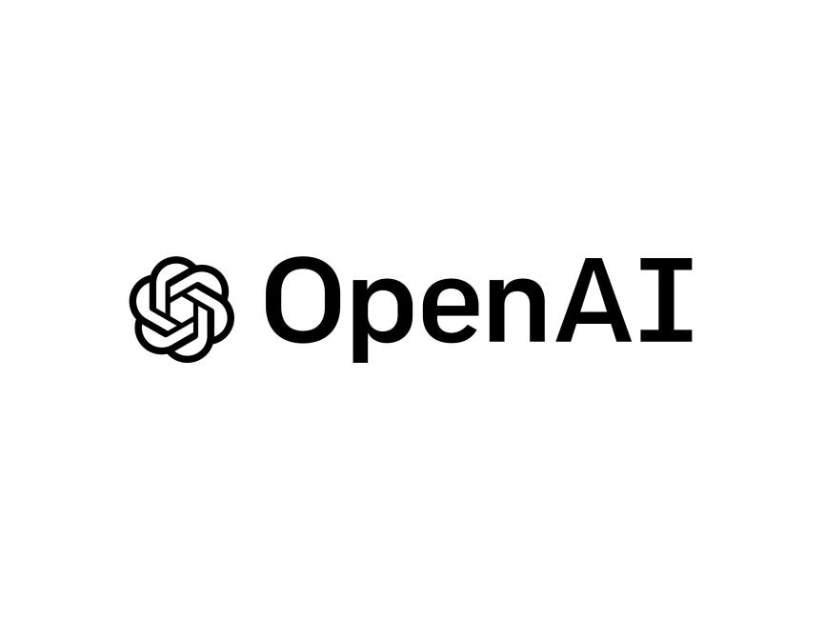
Proof of Concept | FinanceAI Insights Platform
Target client: < Professional Services Provider #9>
Team: Mike Capozzi | Ankur Ch.
Perform analysis & investigation, and provide 1st order insights on demand from multiple financial sources
  Situation
  Significant human time and effort is consumed, analyzing and summarizing financial performance data and reports
  Financial insights can be out-of-date, subjective, or narrowly sourced
  Generative AI can reduce human-ware and latency in insight delivery
  Potential Benefits
On demand access to information for finance professionals, and possibly their customers to perform self-service for information and insights
Enhanced, economic decision making leveraging up-to-date financial information and insights
Reduced reliance on human-ware in ad hoc financial reporting and analysis processes
Reduced latency for available actionable financial information for client decision-making
Lower cost to achieve leveraging Generative AI models vs. traditional automation approaches Shared Services Interaction Layer – Intake / Automation
  Industries:
  Life Sciences and Healthcare
  Financial Services and Insurance
  Tech, Media, and Telecom
  Energy, Resources, and Industrials
  Consumer
  Deloitte / Professional Services
  Business Objectives
  Provide financial analysts access to generative AI capabilities in concert with their financial language and data
  Querying the insights platform would provide forward-looking and current insights, analysis, data and commentary based on the latest financial information of the client
  This capability would drive data-driven decision-making across the client’s organization, and support ad hoc analysis and questions
  Solution Approach
  Generative AI / LLM enabled solution
  Interaction layer to converse with the financial analyst
  Orchestration layer to manage interactions and access to key data sets
  Generative AI / LLM model to perform analysis, summarization, insight generation, report production, and data provisioning
  Train/tune the model based on client's financial language, context, and parameters
  API into financial applications for data sourcing
  Model: Proposed
  Earliest available environment in Deloitte (6/19)

Slide 15

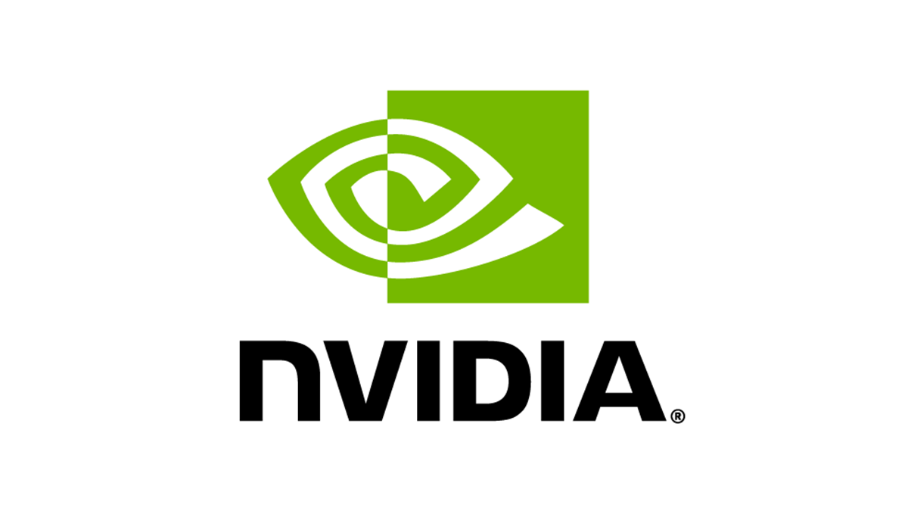

Proof of Concept | Mgmt Reporting – Actuals, Plan, Variance + Commentary production
Target client: TBD
Team: Mike Capozzi | Ankur S.
Produce management reporting & analysis (Version 1) on demand in any medium including insights and commentary
  Situation
  Finance business partners spend more time evaluating data than generating insights
  Developing goal seek scenarios is a time consuming and labor-intensive process
  Even for relatively simple level 0 tasks, multiple stakeholders need to be involved in gathering accurate information
  Potential Benefits
Enhanced and complete data analysis enabled by generative AI models that can analyze large volumes of data in short timeframes
Fully-autonomous management reporting from data collation/reconciliation to commentary and insight creation
Enhanced decision support leveraging virtual finance assistants to inform managers with data-driven decisions
Reduced headcount necessary to create reports and conduct analysis
  Industries:
  Life Sciences and Healthcare
  Financial Services and Insurance
  Tech, Media, and Telecom
  Energy, Resources, and Industrials
  Consumer
  Business Objectives
  Produce first-draft insights and commentary on demand
  Conduct variance analysis and/or data reconciliation between multiple systems automatically
  Generate automated data visualizations with supporting commentary
  Recommend paths for different business management decisions
  Autonomous self-help and user-retrieved information based off prompts
  Solution Approach
  Gather integrated financial/operational datasets from known data sources
  Connect data sources and LLM to an orchestration layer
  Define terminology necessary for LLM to understand the datasets
  Train model on correct terminology and update
  Generate data visualizations and corresponding commentary from the orchestration layer
  Highly dependent on client data maturity, common financial language, and standardization
  Model: TBD on client

Slide 16
Proof of Concept | Shared Services Interaction Layer – Intake / Automation
Target client: < Diversified Health Care Company #1>
Team: Alec Kasuya| Adam Kapasi
Provide a new conversational AI (chatbot) interaction layer where employees can request any services based on free-form request
  Situation
  Shared services customer experience is not consistent due to multiple channels of engagement and limited self-service capability
  Knowledge articles are stalled, not personalized and not easy to identify
  Shared services customers have very limited visibility into case status, resulting in ~30% increase in call volume
  Potential Benefits
Efficiency: 25-40% productivity gains1 through optimizing technology stack and digitizing workflows powered by AI​
Effectiveness: 4-5x ROI in workflow efficiency through streamlined and effective cross functional collaboration​
Experience: 2x increase in customer satisfaction and 25-50% call deflection in call volume through intelligent self-service and coordinated service management​
  Industries:
  Life Sciences and Healthcare
  Financial Services and Insurance
  Government and Public Services
  Tech, Media, and Telecom
  Energy, Resources, and Industrials
  Consumer
  Business Objectives
  Design persona-based customer engagement model to deliver personalized, consistent experience​
  Simplify workflows and interaction models leveraging technology, automation and AI​
  Exploit data-driven insights, analytics and dashboard to drive performance and improve customer retention​
  Solution Approach
  Design Persona-based Interface and Workflow​ based on user journey and the moments that matter​
  Define customer intake channel strategy and refresh knowledge article based on customer persona and journey map
  Integrate AI capability and machine translation to customer engagement channels virtual agent (chatbot) that can provider personalized services based on persona and defined knowledge articles to improve self-service and triage/first call resolution and status dashboard
  Track user feedback and volumetrics to inform continuous improvement and data driven customer retention strategy
  Model:

Slide 17
Proof of Concept | Forecasting & Scenario Modeling – Automated / On Demand
Target client: TBD
Team: Mike Capozzi
Provide end users with on demand forecasting and scenario modeling functionality with complete parameters and drivers flexibility
  Situation
  Finance teams spend significant amounts of time during critical periods to produce and analyze scenarios requested by finance executives
  Merging internal and external datasets (especially operational vs. financial) to accurately generate scenarios is difficult and time consuming
  Manually developing a detailed forecast can take too long to be useful
  Potential Benefits
Improved efficiency due to fewer FTEs required; faster results
Deliver insight by iteratively interacting with a GenAI model to quickly describe, evaluate and modify scenarios with real data
Drive transparency by Identifying/understanding various assumptions and outcomes of scenarios
Use common-language to automatically generate financial drivers that feed financial models
  Industries*:
  Life Sciences and Healthcare
  Financial Services and Insurance
  Tech, Media, and Telecom
  Energy, Resources, and Industrials
  Consumer
  Business Objectives
  Quickly generate financial forecasts based on real time business scenarios
  Increase the speed of delivery for FP&A modeling
  Utilize the current forecasting toolset to create scenarios that match plan/budget
  Generation of real-time suggested actions based on the sync of daily financial and operational data
  Solution Approach
  Identify: Determine the variables to forecast or model
  Collect & Clean Data: Gather and preprocess historical data
  Build & Train Model: Develop and train a predictive or generative AI model
  Validate & Adjust: Test the model on unseen data and refine as needed
  Implement & Monitor: Deploy the model, monitor performance, and make updates
  Iterate: Continually revise and improve the model with new data and insights
  Model:
*Non-Exhaustive

Slide 18
Proof of Concept | Journal Entry Automation
Target client: <Insurance Brokerage Firm #13>
Team: Gabe Holtz | Mike Capozzi
Automating the creation of the journal entry processes leveraging generative AI to engage and gather details used to develop journal entries that would normally occur via emails or close meetings.
  Situation
  Closing timelines are tight and exasperated with emails and meetings to complete tasks to adjust, consolidate, and explain variances across the business
  Limited calendar openings that place stress on close milestones and compliance
  Inconsistency and siloed systems, metadata and business changes restrict the flow of information needed to be reflected in internal and external reporting
  Potential Benefits
Quicker time to close
Documented support, through the AI generated conversations with business and functions
Reduced workload for key resources during monthly/quarterly close
Foundational data gathering for reporting and variance inferences
Reliable audit trail, enabling better traceability
AJE validation meetings are minimized, allowing the team more time to analyze and interpret results
  Industries*:
  Life Sciences and Healthcare
  Financial Services and Insurance
  Tech, Media, and Telecom
  Energy, Resources, and Industrials
  Consumer
  Business Objectives
  Automate the information gathering requirements to prepare AJEs (e.g., accruals for GR/IR, contracts spanning multiple periods)
  Spend more time analyzing variances from prior periods
  Automate data gathering, increase productivity
  Accounting to be able to accommodate the increasing complexity as the business grows
  Increased transparency to auditors
  Better financial insights and decision-making
  Solution Approach
  Train a Gen AI model to collect historical patterns, closing activities and stakeholders
  Define business and functional stakeholders to engage for closing activities
  Clean and preprocess input data
  Engage stakeholders to develop and document AJEs and narratives for reporting
  Summarize, document, and send proposed AJEs to applicable Accounting team
  Model:
*Non-Exhaustive

Slide 19
Proof of Concept | Investor Relations Analyst Augmentation
Target client: TBD
Team: Ankur Saxena | Will Ahl
Automate, accelerate and generate 1st version artifacts for earnings and investors (e.g., Earnings transcript, Q&A prep, articles, 10K/10Q)
  Situation
  Investor relations (IR) can be complex and time-consuming, with high expectations and difficult stakeholders
  Many core investor relations activities fall within a short time frame, making automation very valuable
  Earnings calls and the associated materials are a critical interaction between the company and its investors
  Potential Benefits
Improve efficiency by automating routine tasks and freeing up time of investor relations team to focus on strategic tasks such as developing communication strategies
Improve consistency by using GenAI to ensure that communications are consistent in their messaging and formatting, reducing the risk of errors or confusion, and improving the quality of investor communications
Ensure compliance with relevant regulations and standards, and reduce legal and regulatory risks to help improve trust among investors
  Industries:
  Life Sciences and Healthcare
  Financial Services and Insurance
  Tech, Media, and Telecom
  Energy, Resources, and Industrials
  Consumer
  Business Objectives
  Utilize Generative AI to produce the script for the ~5-minute financial update on an earnings call
  Script will include basic narratives such as period over period changes, business updates, high-level financial analysis (from the 10Q)
  The script will also incorporate industry specific transcript credentials, grounded in the analysis of key competitor data
  Solution Approach
  The T-5 model facilitates the generation of articles based on key facts and figure provided
  The model further provides top X number of processed and filtered articles for POC based on rough L-Score
  The model is fine tuned to generate articles for further investor communication
  As next steps, manual amendments can be made to the output generated by OpenAI LLM model
  Model:

